Slide 1
RevoU Proposal
A competitor analysis of 13 schools

Slide 2
Admissions Process
Interview + Test
Hacktiv8
RevoU
Interview
Algoritma
Evolve
Rubicamp
Koding Next
RevoU:
Interview + Test to show “exclusivity” to promote best of the best. If fail, re-try for next batch
224
112
30
None
Purwadhika
Codepolitan
ImpactByte
NextAcademy

Slide 3
Scholarships
Scholarships offered
Codepolitan (100%)
Purwadhika (100%)
ImpactByte (25%)
**Financial aid, women, people with disabilities
RevoU:
Dive into companies (Astra, Adaro) that have a CSR budget to allocate
Referral program if not scholarship-ready
Do not offer Scholarships
RevoU

Slide 4
Referral Programs
Mentorship Model
Refer 3 people, get a free mentorship season
1 person = 15 mins
2 people = 30 mins
3 people = 45 mins (max)
Package Model
Get 5 people together at once, all get Rp 1,000,000 discount together.
**Codepolitan

Slide 5
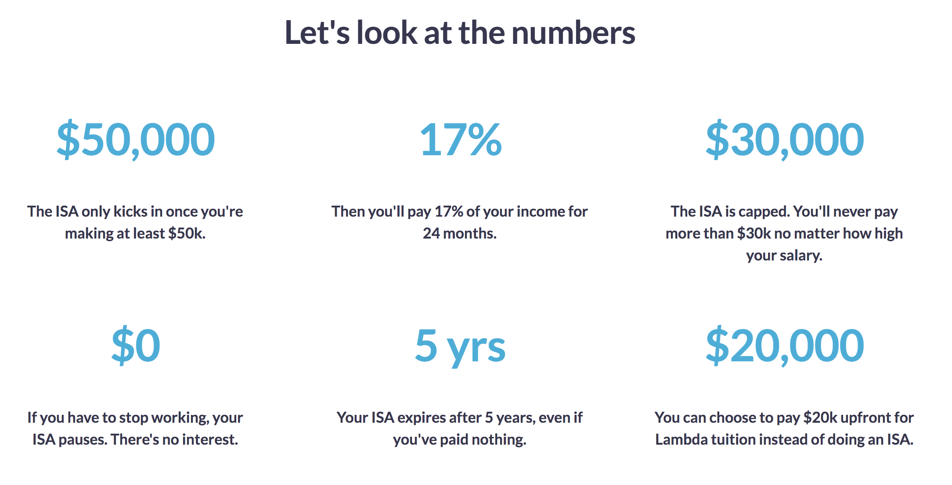
Income Sharing Agreement
60% now, 40% later
Rubicamp
RevoU:
Tiered system and set percentages based on amount earned (like Lambda). For ex, if you earned 10 million, 2 million is a lot.
2 million each month after graduating = 24 million
Arkademy
Do not use it
RevoU
Source: Lambda Academy

Slide 6
Acceptance Rate
RevoU:
It depends on how selective we want to be + how focused we want the 1v1 interaction to be.
2%
10%
25%
80%
100%
Arkademy
Rubicamp
Hacktiv8
Algoritma
Purwadhika

Slide 7
Tuition Cost
Offline Full Stack Development Courses

Slide 8
Tuition Cost
Online Full Stack Development Courses
RevoU
15,000,000
Arkademy
39,000
kode.id
270,000
Codepolitan
675,000
Dicoding
1,100,000

Slide 9
Tuition Cost
RevoU:
Keep charging 15,000,000 for now, but look for feedback in the future after first batch (Politekniks, SMK students esp).
Installment Plans
Rp 1,000,000 a month until 15,000,000
Offline Activities
Company Visits + Hotel
Hackathons
Bi-weekly meetings
**Used by NextAcademy
Synchronous, real-time classroom mentorship aspect with interactive elements

Slide 10
Mentorships
Mentor Ratios
1:3 Rubicamp
1:1, 1:5 NextAcademy
1:15 ImpactByte
RevoU:
1:3 RevoU mentor
*1v1 weekly calls
1:20/30 RevoU teacher
*offline bi-weekly visits
TEACHER
*live Q&A, Codepolitan

Slide 11
Class Size
3-10 students
Rubicamp
KodingNext
11-50 students
NextAcademy
Algoritma
Hacktiv8
Purwadhika
RevoU
RevoU:
Cap off < 30 students to keep track of work, similar to offline classes
50+ students
Refactory
Dicoding

Slide 12
Duration
RevoU:
Average amount of 10-12 weeks (digital marketing)
15 weeks (coding)
3 months = new batch

Slide 13
Testing System
RevoU:
RevoU Tests | Model | System | How it Works
Midterm | Hacktiv8, Purwadhika | Quizzes | Reach 80%, if not can re-take to get higher score. Better score, better chances
Final | Codepolitan | Presentation, project, hackathon | Win a prize + funding if top 3 project

Slide 14
Scoring System
Scoring | Incentive
80-100% | LinkedIn Crash Course Interview Preparation + Tips 1on1 hour-long coaching meet ups Career day to meet with employers
60-80% | LinkedIn Crash Course Interview Preparation + Tips Group coaching
< 60% | LinkedIn Crash Course Interview Preparation + Tips

Slide 15
Refund Policy
Hacktiv8
Algoritma
Phase 0 = 5 million
Phase 1-3 = no passing (2 attempts) no refund, just move on to next phase with low grade
70% of amount, regardless when dropping out

Slide 16
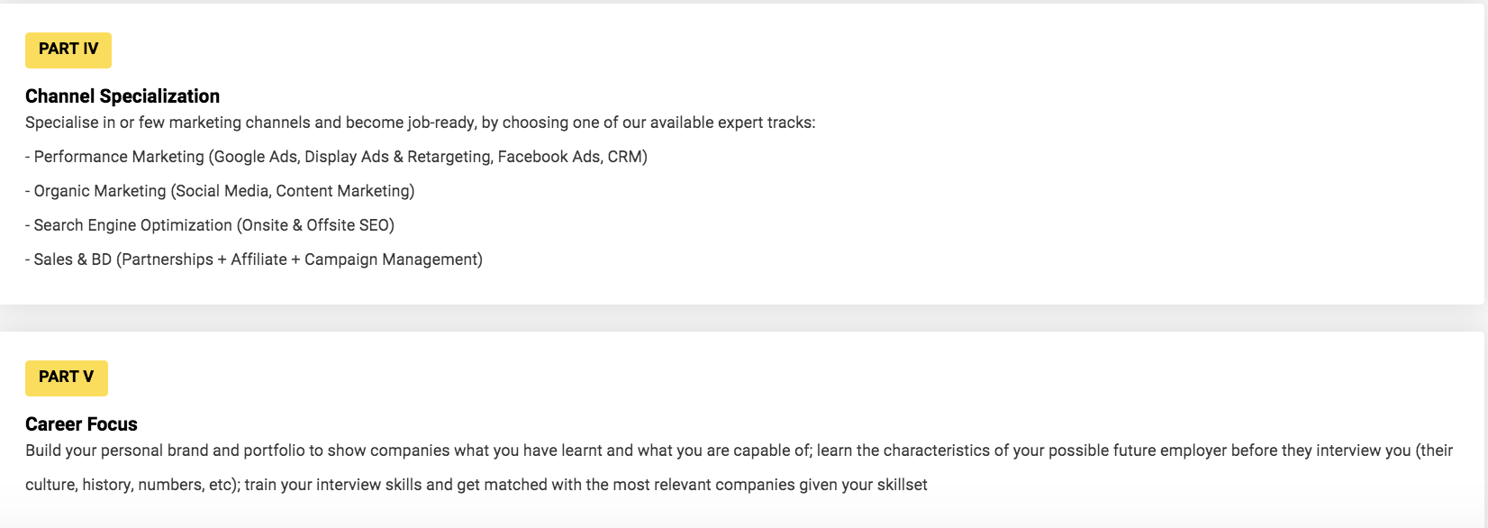
Refund Policy
Implement a tiered system, similar to Hacktiv8.
For ex:
50% refund
25% refund
0 refund

Slide 17
Other unique ideas
Refactory
Arkademy
Preparation program before class starts
Uses a discussion forum to promote real time Q&A
Dicoding
Codepolitan
Take the course for free, then participate in Hackathons & events to exchange points for prizes
Dissatisfied with the final product and website you have created = 1v1 meeting with the team and full refund

Slide 18
Job Guarantee
RevoU:
After calling Purwadhika & Hacktiv8, they still assured that we would get a 100% guaranteed job + there is nothing on their website on the guarantee (unlike Lambda + Springboard)
This could be a huge selling point for RevoU.

Slide 19
Recap
Keep
Implement
Admissions
Referrals first, then scholarships
Tuition
Duration, frequency (every 3 months)
Tiered system for ISA
Installment plans, live Q&A, offline meet ups
Mentorship ratios
Cap classes at <30
Midterm Quizzes + Final Projects
Refund system

Slide 20
Thank you!
Matthew Ong

